Slide 1
Status shortfall and non-conformity: An extension in the Scotch whisky industry

Slide 2
RQ: To what extent do status loss and status gain lead to organizational deviancy?
Financial/tangible performance feedback leads to increased search and change behavior
  Not a lot of work on intangible performance feedback
Meta-analysis indicates that non-financial performance feedback is a stronger driver of change than financial PF (Verver et al., 201X)
Rates of change: √
Direction of change: ?
Hence: we are rather unable to specifically clarify organizational choices in response to performance feedback
Therefore: To what extent do status loss and gain lead to organizational change?

Slide 3
Middle-status conformity theory vs. performance feedback theory
Middle-status conformity theory: status leads to (non)conforming behavior (Phillips & Zuckerman, 2001)
  Low-status: non-conforming behavior
  Middle-status: maintain status quo
  High-status: non-conforming behavior
Performance feedback theory: feedback leads to search and change
  Performance below aspiration: increase search and change
  Performance around aspiration: no search or change
  Performance above aspiration: increase search and change
Conclusion: Predictions highly similar but arguments complementary (rate and direction of change)

Slide 4
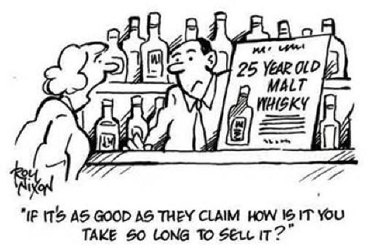
With-Age Statement whisky vs.
Non-Age Statement Whisky

Slide 5
“If you ask me, it’s hardly surprising there’s so much confusion about whether age statements are important and what they really stand for. When you hear so many conflicting views, who are you supposed to trust?” (scotchwhisky.com, 2016)
“Overall, there’s growing acceptance of NAS products, even if they do seem to be somewhat hit-or-miss” (Marketwatchmag.com, 2017)

Slide 6
Study 1: Evaluations of non-conforming behavior
Category-spanning (non-conforming behavior) leads to lower evaluations (Hsu, 2006; Negro, Hannan, & Rao, 2010)
Initial organizational status might interact with this
We designed a 2 x 3 factorial experiment
IV1: Conforming vs. non-conforming conditions
  Launch of WAS product vs. NAS product
IV2: Low, middle, and high status conditions
  Varying amounts of awards / managed by renowned distiller or not / good, average, or bad reviews by critics
DV: willingness-to-pay, authenticity, status
We aim to establish with a group of whisky enthusiasts whether non-conforming behavior has intangible performance consequences

Slide 7
Study 2: Status loss/gain and organizational deviancy
Conduct a panel data study of Scotch single malt distillers
Status-based performance = #awards in international competitions
Status-based aspiration = #awards in international competitions, t-1
IV = Performance – aspiration
DV = New product launches
  #NAS whiskies per year / #whiskies per year

